Slide 1
Chapter 2
Performance Issues
Yunju Baek
yunju@pusan.ac.kr

Slide 2
Designing for Performance
The cost of computer systems continues to drop dramatically, while the performance and capacity of those systems continue to rise equally dramatically
Today’s laptops have the computing power of an IBM mainframe from 10 or 15 years ago
Processors are so inexpensive that we now have microprocessors we throw away

Slide 3
Designing for Performance
Desktop applications that require the great power of today’s microprocessor-based systems include:
  Image processing
  Three-dimensional rendering
  Speech recognition
  Videoconferencing
  Multimedia authoring
  Voice and video annotation of files
  Simulation modeling

Slide 4

Designing for Performance
Businesses are relying on increasingly powerful servers to handle transaction and database processing and to support massive client/server networks that have replaced the huge mainframe computer centers of yesteryear
  Cloud service providers use massive high-performance banks of servers to satisfy high-volume, high-transaction-rate applications for a broad spectrum of clients

Slide 5
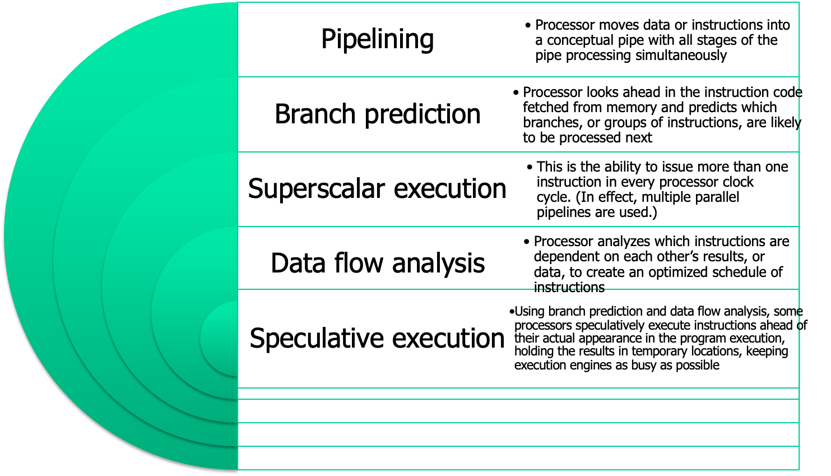
Microprocessor Speed
Techniques built into contemporary processors include:
© 2016 Pearson Education, Inc., Hoboken, NJ. All rights reserved.
Notes:
What gives Intel x86 processors or IBM mainframe computers such mind-boggling
power is the relentless pursuit of speed by processor chip manufacturers. The evolution
of these machines continues to bear out Moore’s law, mentioned previously. So
long as this law holds, chipmakers can unleash a new generation of chips every three
years—with four times as many transistors. In memory chips, this has quadrupled
the capacity of dynamic random-access memory (DRAM), still the basic technology
for computer main memory, every three years. In microprocessors, the addition of
new circuits, and the speed boost that comes from reducing the distances between
them, has improved performance four- or fivefold every three years or so since Intel
launched its x86 family in 1978.
But the raw speed of the microprocessor will not achieve its potential unless
it is fed a constant stream of work to do in the form of computer instructions.
Anything that gets in the way of that smooth flow undermines the power of the
processor. Accordingly, while the chipmakers have been busy learning how to fabricate
chips of greater and greater density, the processor designers must come up with
ever more elaborate techniques for feeding the monster. Among the techniques
built into contemporary processors are the following:
Pipelining:
The execution of an instruction involves multiple stages of operation,
including fetching the instruction, decoding the opcode, fetching operands,
performing a calculation, and so on. Pipelining enables a processor to
work simultaneously on multiple instructions by performing a different phase
for each of the multiple instructions at the same time. The processor overlaps
operations by moving data or instructions into a conceptual pipe with all
stages of the pipe processing simultaneously. For example, while one instruction
is being executed, the computer is decoding the next instruction. This is
the same principle as seen in an assembly line.
• Branch prediction:
The processor looks ahead in the instruction code fetched
from memory and predicts which branches, or groups of instructions, are likely
to be processed next. If the processor guesses right most of the time, it can
prefetch the correct instructions and buffer them so that the processor is kept
busy. The more sophisticated examples of this strategy predict not just the
next branch but multiple branches ahead. Thus, branch prediction increases
the amount of work available for the processor to execute.
• Superscalar execution:
This is the ability to issue more than one instruction
in every processor clock cycle. In effect, multiple parallel pipelines are used.
• Data flow analysis:
The processor analyzes which instructions are dependent
on each other’s results, or data, to create an optimized schedule of instructions.
In fact, instructions are scheduled to be executed when ready, independent of
the original program order. This prevents unnecessary delay.
• Speculative execution:
Using branch prediction and data flow analysis, some
processors speculatively execute instructions ahead of their actual appearance
in the program execution, holding the results in temporary locations.
This enables the processor to keep its execution engines as busy as possible by
executing instructions that are likely to be needed.
These and other sophisticated techniques are made necessary by the sheer
power of the processor. Collectively they make it possible to execute many instructions
per processor cycle, rather than to take many cycles per instruction.
© 2016 Pearson Education, Inc., Hoboken, NJ. All rights reserved.

Slide 6
Performance Mismatch
Processor speed increased
Memory capacity increased
Memory speed lags behind processor speed

Slide 7
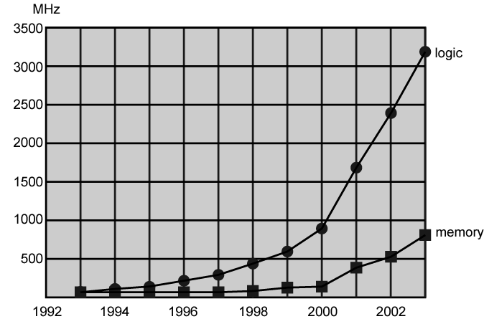
Logic and Memory Performance Gap

Slide 8
Performance Balance
Adjust the organization and architecture to compensate for the mismatch among the capabilities of the various components
Architectural examples include:
  Increase the number of bits that are retrieved at one time by making DRAMs “wider” rather than “deeper” and by using wide bus data paths
  Change the DRAM interface to make it more efficient by including a cache or other buffering scheme on the DRAM chip
  Reduce the frequency of memory access by incorporating increasingly complex and efficient cache structures between the processor and main memory
  Increase the interconnect bandwidth between processors and memory by using higher speed buses and a hierarchy of buses to buffer and structure data flow
© 2016 Pearson Education, Inc., Hoboken, NJ. All rights reserved.
Notes:
While processor power has raced ahead at breakneck speed, other critical components
of the computer have not kept up. The result is a need to look for performance
balance: an adjusting of the organization and architecture to compensate for the
mismatch among the capabilities of the various components.
The problem created by such mismatches is particularly critical at the
interface between processor and main memory. While processor speed has grown
rapidly, the speed with which data can be transferred between main memory and the
processor has lagged badly. The interface between processor and main memory is
the most crucial pathway in the entire computer because it is responsible for carrying
a constant flow of program instructions and data between memory chips and the
processor. If memory or the pathway fails to keep pace with the processor’s insistent
demands, the processor stalls in a wait state, and valuable processing time is lost.
A system architect can attack this problem in a number of ways, all of which
are reflected in contemporary computer designs. Consider the following examples:
• Increase the number of bits that are retrieved at one time by making DRAMs
“wider” rather than “deeper” and by using wide bus data paths.
• Change the DRAM interface to make it more efficient by including a cache
or other buffering scheme on the DRAM chip.
• Reduce the frequency of memory access by incorporating increasingly complex
and efficient cache structures between the processor and main memory. This
includes the incorporation of one or more caches on the processor chip as well
as on an off-chip cache close to the processor chip.
• Increase the interconnect bandwidth between processors and memory by using
higher-speed buses and a hierarchy of buses to buffer and structure data
flow.
© 2016 Pearson Education, Inc., Hoboken, NJ. All rights reserved.

Slide 9
Improvements in Chip Organization and Architecture
Increase hardware speed of processor
  Fundamentally due to shrinking logic gate size
    More gates, packed more tightly, increasing clock rate
    Propagation time for signals reduced
Increase size and speed of caches
  Dedicating part of processor chip
    Cache access times drop significantly
Change processor organization and architecture
  Increase effective speed of execution
  Parallelism

Slide 10
Problems with Clock Speed and Logic Density
Power
  Power density increases with density of logic and clock speed
  Dissipating heat
RC delay
  Speed at which electrons flow limited by resistance and capacitance of metal wires connecting them
  Delay increases as RC product increases
  Wire interconnects thinner, increasing resistance
  Wires closer together, increasing capacitance
Memory latency
  Memory speeds lag processor speeds
Solution:
  More emphasis on organizational and architectural approaches

Slide 11
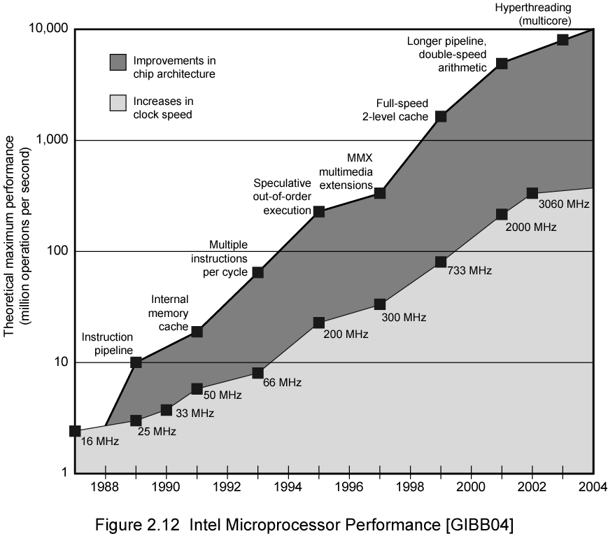
Intel Microprocessor Performance

Slide 12
Increased Cache Capacity
Typically two or three levels of cache between processor and main memory
Chip density increased
  More cache memory on chip
    Faster cache access
Pentium chip devoted about 10% of chip area to cache
Pentium 4 devotes about 50%

Slide 13
More Complex Execution Logic
Enable parallel execution of instructions
Pipeline works like assembly line
  Different stages of execution of different instructions at same time along pipeline
Superscalar allows multiple pipelines within single processor
  Instructions that do not depend on one another can be executed in parallel

Slide 14
Diminishing Returns
Internal organization of processors complex
  Can get a great deal of parallelism
  Further significant increases likely to be relatively modest
Benefits from cache are reaching limit
Increasing clock rate runs into power dissipation problem
  Some fundamental physical limits are being reached

Slide 15
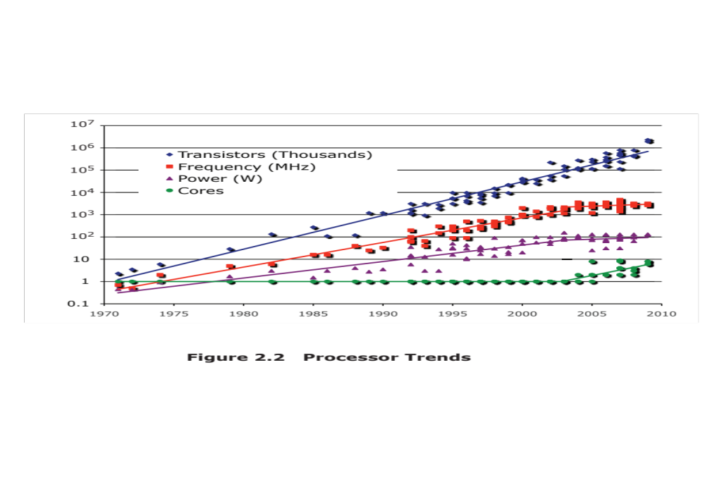
© 2016 Pearson Education, Inc., Hoboken, NJ. All rights reserved.
Notes:
Beginning in the late 1980s, and continuing for about 15 years, two main
strategies have been used to increase performance beyond what can be achieved
simply by increasing clock speed. First, there has been an increase in cache capacity.
There are now typically two or three levels of cache between the processor and
main memory. As chip density has increased, more of the cache memory has been
incorporated on the chip, enabling faster cache access. For example, the original
Pentium chip devoted about 10% of on-chip area to caches. Contemporary chips
devote over half of the chip area to caches. And, typically, about three-quarters of the
other half is for pipeline-related control and buffering.
Second, the instruction execution logic within a processor has become increasingly
complex to enable parallel execution of instructions within the processor. Two
noteworthy design approaches have been pipelining and superscalar. A pipeline
works much as an assembly line in a manufacturing plant enabling different stages
of execution of different instructions to occur at the same time along the pipeline. A
superscalar approach in essence allows multiple pipelines within a single processor
so that instructions that do not depend on one another can be executed in parallel.
By the mid to late 90s, both of these approaches were reaching a point of
diminishing returns. The internal organization of contemporary processors is
exceedingly complex and is able to squeeze a great deal of parallelism out of the
instruction stream. It seems likely that further significant increases in this direction
will be relatively modest [GIBB04]. With three levels of cache on the processor
chip, each level providing substantial capacity, it also seems that the benefits from
the cache are reaching a limit.
However, simply relying on increasing clock rate for increased performance
runs into the power dissipation problem already referred to. The faster the clock
rate, the greater the amount of power to be dissipated, and some fundamental physical
limits are being reached.
Figure 2.2 illustrates the concepts we have been discussing. The top line
shows that, as per Moore’s Law, the number of transistors on a single chip continues
to grow exponentially. Meanwhile, the clock speed has leveled off, in order
to prevent a further rise in power. To continue to increase performance, designers
have had to find ways of exploiting the growing number of transistors other than
simply building a more complex processor. The response in recent years has been
the development of the multicore computer chip.
© 2016 Pearson Education, Inc., Hoboken, NJ. All rights reserved.

Slide 16

New Approach – Multiple Cores
Multiple processors on single chip
  Large shared cache
Within a processor, increase in performance proportional to square root of increase in complexity
If software can use multiple processors, doubling number of processors almost doubles performance
So, use two simpler processors on the chip rather than one more complex processor
With two processors, larger caches are justified
  Power consumption of memory logic less than processing logic

Slide 17
Many Integrated Core (MIC)
Graphics Processing Unit (GPU)
MIC
GPU
Leap in performance as well as the challenges in developing software to exploit such a large number of cores
The multicore and MIC strategy involves a homogeneous collection of general purpose processors on a single chip
Core designed to perform parallel operations on graphics data
Traditionally found on a plug-in graphics card, it is used to encode and render 2D and 3D graphics as well as process video
Used as vector processors for a variety of applications that require repetitive computations
Notes:
Chip manufacturers are now in the process of making a huge leap forward
in the number of cores per chip, with more than 50 cores per chip. The leap in
performance as well as the challenges in developing software to exploit such a large
number of cores have led to the introduction of a new term: many integrated core
(MIC).
The multicore and MIC strategy involves a homogeneous collection of
general-purpose processors on a single chip. At the same time, chip manufacturers
are pursuing another design option: a chip with multiple general-purpose processors
plus graphics processing units (GPUs) and specialized cores for video processing
and other tasks. In broad terms, a GPU is a core designed to perform parallel
operations on graphics data. Traditionally found on a plug-in graphics card (display
adapter), it is used to encode and render 2D and 3D graphics as well as process
video.
Since GPUs perform parallel operations on multiple sets of data, they are
increasingly being used as vector processors for a variety of applications that
require repetitive computations. This blurs the line between the GPU and the
CPU [FATA08, PROP11]. When a broad range of applications are supported
by such a processor, the term general-purpose computing on GPUs (GPGPU)
is used.
We explore design characteristics of multicore computers in Chapter 18 and
GPGPUs in Chapter 19.
© 2016 Pearson Education, Inc., Hoboken, NJ. All rights reserved.

Slide 18
Performance Assessment
Clock Speed
Key parameters
  Performance, cost, size, security, reliability, power consumption
System clock speed
  In Hz or multiples of
  Clock rate, clock cycle, clock tick, cycle time
Signals in CPU take time to settle down to 1 or 0
Signals may change at different speeds
Operations need to be synchronised
Instruction execution in discrete steps
  Fetch, decode, load and store, arithmetic or logical
  Usually require multiple clock cycles per instruction
Pipelining gives simultaneous execution of instructions
So, clock speed is not the whole story

Slide 19
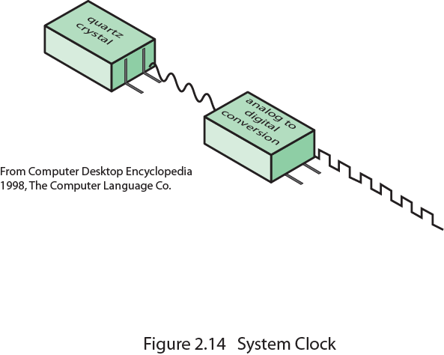
System Clock

Slide 20
Instruction Execution Rate
Millions of instructions per second (MIPS)
Millions of floating point instructions per second (MFLOPS)
Heavily dependent on instruction set, compiler design, processor implementation, cache & memory hierarchy

Slide 21
Benchmarks
Programs designed to test performance
Written in high level language
  Portable
Represents style of task
  Systems, numerical, commercial
Easily measured
Widely distributed
E.g. System Performance Evaluation Corporation (SPEC)
  CPU2006 for computation bound
    17 floating point programs in C, C++, Fortran
    12 integer programs in C, C++
    3 million lines of code
  Speed and rate metrics
    Single task and throughput

Slide 22

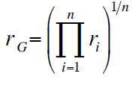
SPEC Speed Metric
Single task
Base runtime defined for each benchmark using reference machine
Results are reported as ratio of reference time to system run time
  Tref_{i} execution time for benchmark i on reference machine
  Tsut_{i} execution time of benchmark i on test system
Overall performance calculated by averaging ratios for all 12 integer benchmarks
  Use geometric mean
    Appropriate for normalized numbers such as ratios

Slide 23
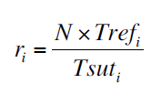
SPEC Rate Metric
Measures throughput or rate of a machine carrying out a number of tasks
Multiple copies of benchmarks run simultaneously
  Typically, same as number of processors
Ratio is calculated as follows:
  Tref_{i} reference execution time for benchmark i
  N number of copies run simultaneously
  Tsuti elapsed time from start of execution of program on all N processors until completion of all copies of program
  Again, a geometric mean is calculated

Slide 24
Amdahl’s Law
Gene Amdahl [AMDA67]
Potential speed up of program using multiple processors
Concluded that:
  Code needs to be parallelizable
  Speed up is bound, giving diminishing returns for more processors
Task dependent
  Servers gain by maintaining multiple connections on multiple processors
  Databases can be split into parallel tasks

Slide 25
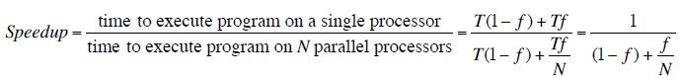
Amdahl’s Law Formula
For program running on single processor
  Fraction f of code infinitely parallelizable with no scheduling overhead
  Fraction (1-f) of code inherently serial
  T is total execution time for program on single processor
  N is number of processors that fully exploit parralle portions of code
Conclusions
  f small, parallel processors has little effect
  N ->∞, speedup bound by 1/(1 – f)
    Diminishing returns for using more processors

Slide 26
Summary
Performance
Issues
Chapter 2
Designing for performance
  Microprocessor speed
  Performance balance
  Improvements in chip organization and architecture
Multicore
MICs
GPGPUs
Amdahl’s Law
  Basic measures of computer performance
  Clock speed
  Instruction execution rate
  Benchmark principles
  SPEC benchmarks
© 2016 Pearson Education, Inc., Hoboken, NJ. All rights reserved.
Notes:
Chapter 2 summary.
© 2016 Pearson Education, Inc., Hoboken, NJ. All rights reserved.

